Slide 1


Slide 2



Gold Partner
Venue Partner
Learning Partner

Slide 3

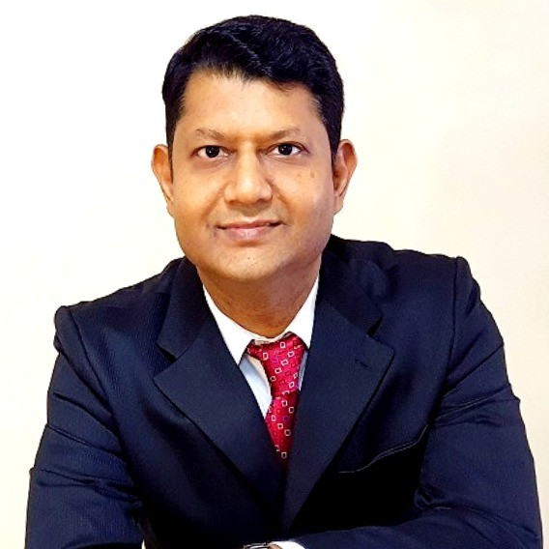
SACHIN K MANJHI
CHIEF ANALYTICS & AI OFFICE
NEOSTATS ANALYTICS

Slide 4
Empowering Efficiency
How Generative AI is Transforming Financial & Public Sector Enterprises ?

Slide 5





Agenda
About NeoStats
Generative AI
Public Sector – Judicial Review
Banking Application – Call Centre AI
Q&A

Slide 6


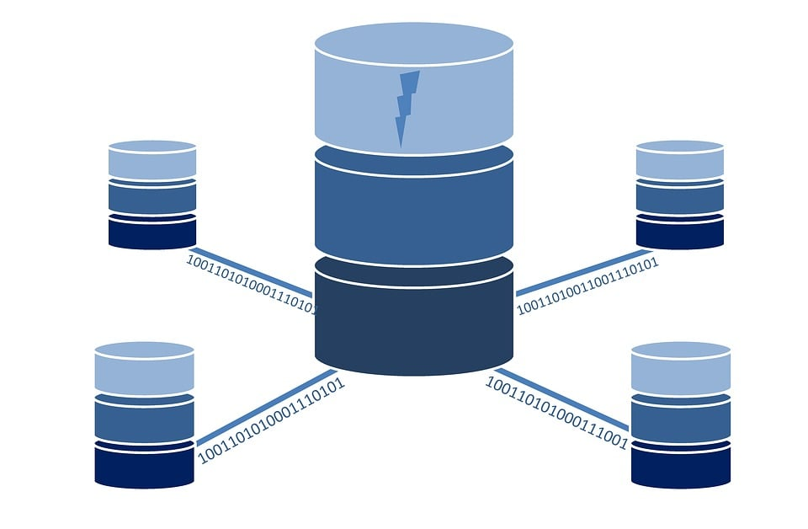
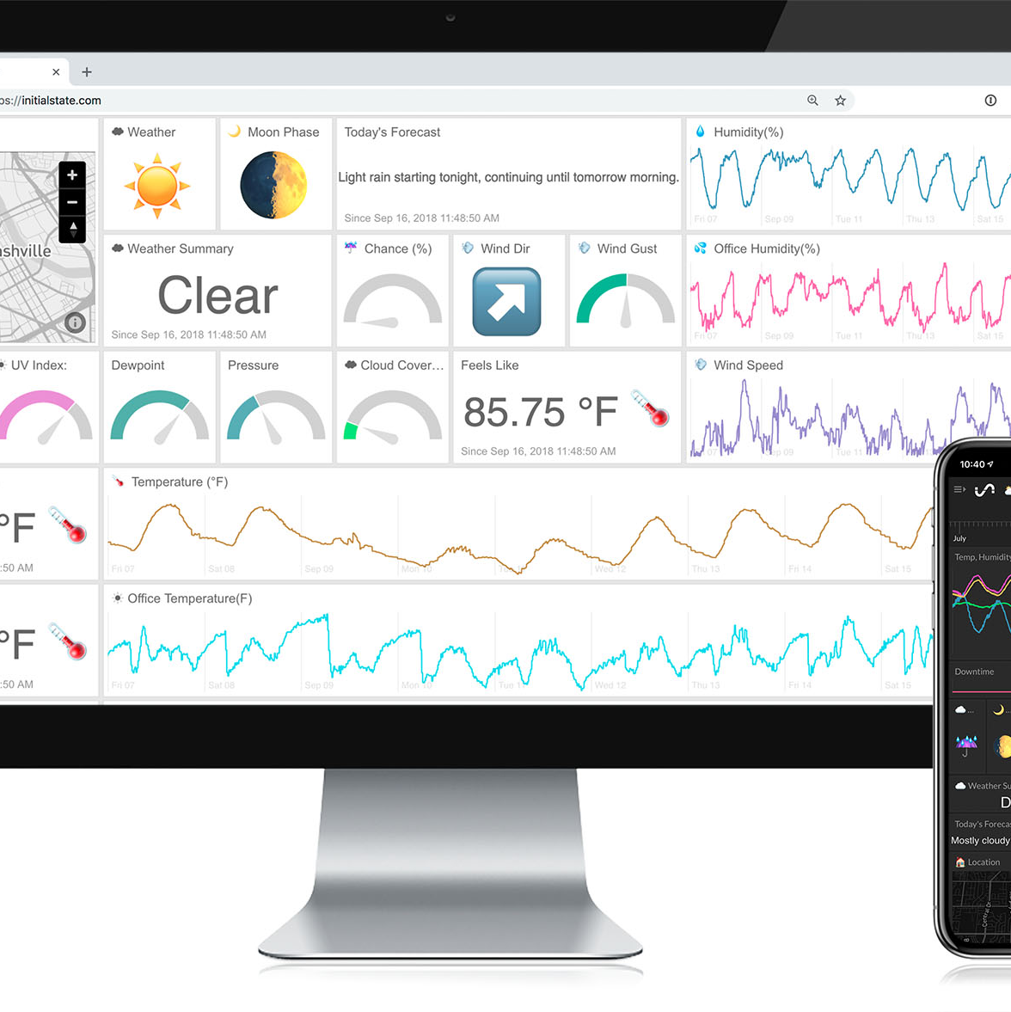



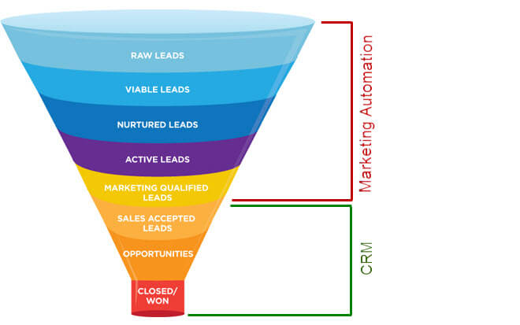
About NeoStats
NeoStats is a one stop data and analytics, strategy-to-execution firm.
We offer a Comprehensive suite of Data Science and BI solutions to optimize your operations, reduce costs, and improve customer satisfaction.
We are industry veterans and senior practitioners from leading organizations.
Data Engineering
BI & Analytics
Data & AI Governance
AI & GenAI
Digital & Enterprise Transformation
Marketing Automation

Slide 7
What can Generative AI do ?
Global Azure 2024, a vibrant space,
where good practices bloom, challenges we embrace.
Success stories whispered, like winds through the trees,
as Microsoft Stack unites us, setting minds free.
Ideas2IT hosts, where knowledge takes flight,
on April 27th, from morning till night.
300 seats, a digital badge to wear,
Don’t miss this azure symphony, in the air.
Write a Poem…

Slide 8

What can Generative AI do ?
Generate an Image

Slide 9
What can Generative AI do ?
# 8 Queen problem in Chess
def solve(col):
# If all queens are placed, print the solution
if col == N:
for row in board:
print(row)
print()
return True
# Try all rows in the current column
for i in range(N):
if is_safe(i, col):
# Place a queen
board[i][col] = 1
# Recur for the next column
if solve(col + 1):
return True
# Backtrack and remove the queen
board[i][col] = 0
# No solution exists for this column
return False
# Call the solve function from the first column
if not solve(0):
print("No solution exists")
Write code

Slide 10
What can Generative AI do – For Business ?
Document Summarization
Code Generation
Chatbot /
Q&A
Language
Translation
Image Generation
Image Identification
Face Recognition
Optical Character Recognition
Voice Generation
Speech to Text
Identification of Profane words
Sentiment Analysis

Slide 11
What is Generative AI ?

Slide 12
What is Generative AI ?
Generative AI models are deep learning models that generate a variety of (unstructured and new) outputs based on massive training datasets and prompts from users.
Generative AI model can:
generate or summarize text
translate text into image outputs and vice-versa
synthesize speech and audio
create original video content
generate synthetic data
generate code
and much more …

Slide 13
What is Generative AI ?
Types of Generative AI Models
Generative Adversarial Networks (GANs) – good for image generation
Variational Autoencoders (VAEs) – good for text generation, classification, translation.
Autoregressive Models – sequential data like text or voice
Transformers – with self-attention mechanism, well suited for all kinds of NLP tasks

Slide 14









GenAI - Large Language Models
Large language models fundamentally predict the next words (represented as numerical tokens) in sequence like auto-complete.
Words are tokenized into numbers and the model processes these “tokens” while dealing with context, nearness, and weights in the neural network and iterating on them as the model is trained
Structured Data
Sentiment Analysis
Information Extraction
Trained on huge amount of data
Adaption to Use case
(Prompting / Fine-tuning)
Text Data
Pretrained Large Language Model
(GPT-4)
Voice
Images
Question & Answer
Instruction Following

Slide 15
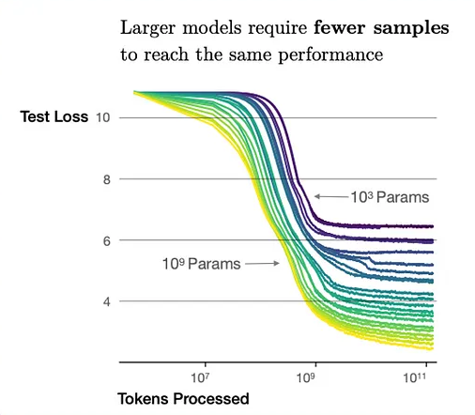
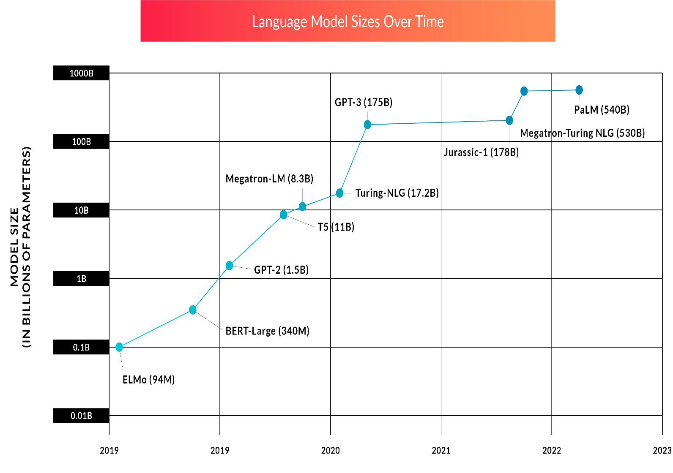
Generative AI - The Size Advantage

Slide 16
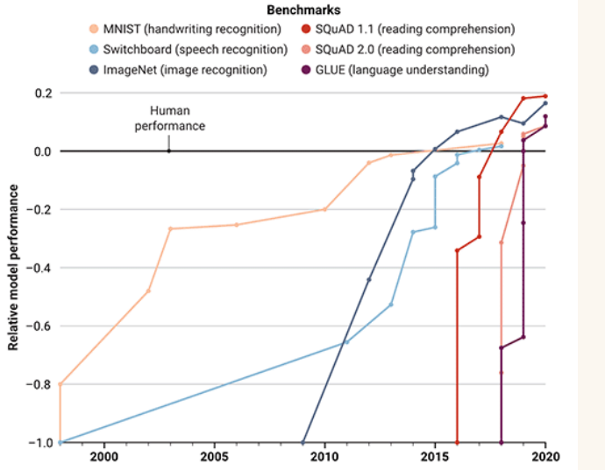
Generative AI - Intelligence Accelerated !

Slide 17
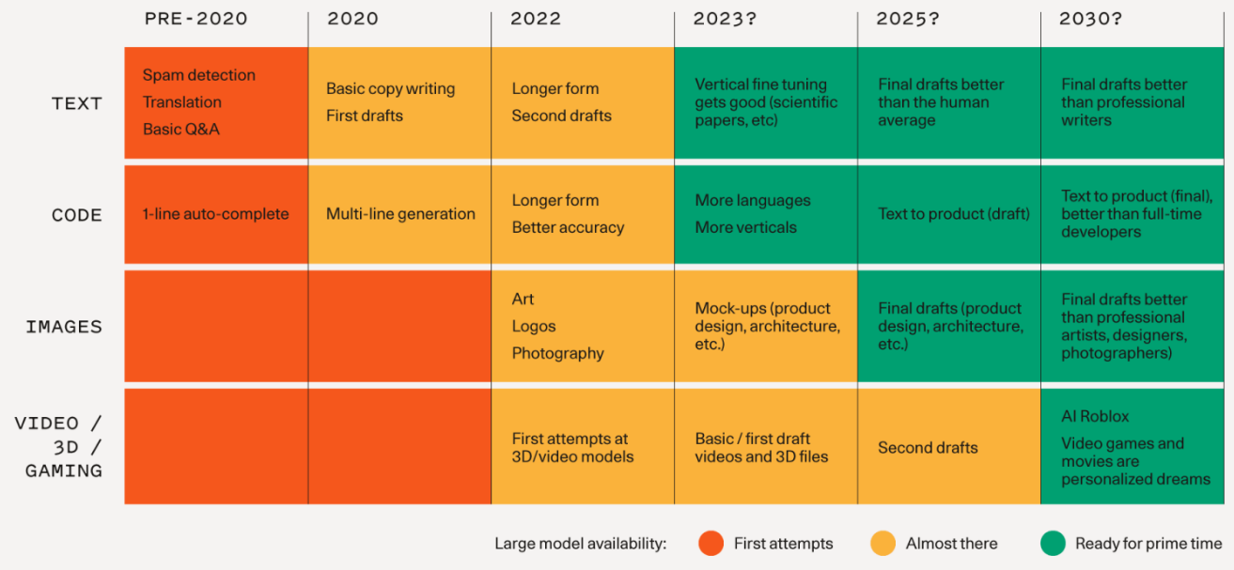
Generative AI - Work Re-Imagined !

Slide 18

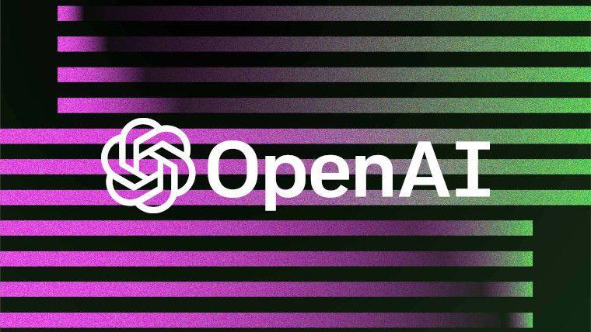











GenAI @ NeoStats
Specializations
Partnerships
Industries
AI/ML Application Design
AI Strategy Development
User Training & Support
Tech Talks & Keynotes
LLM Finetuning
RAG(Retrieval Augmented Generation)
Model Monitoring and Observability
Deployment & Integration
Data Readiness & Labelling
Banking
Insurance
Retail
Government
Telecom

Slide 19








GenAI Solutions @ NeoStats
Call Centre Analytics
Smart Search
H&S Policy Advisor
Documents Summarization
Judge CoPilot
Tax Portal Chatbot
Travel Advisor
Resume Parser

Slide 20

Call Centre Analytics
Industry Challenges:
Low Visibility - Firm unaware of Complaints & Customer experience
Outsourcing - Dependency on agent's feedback
Manual QA – Take a long time to identify issues and rectify them
Low Coverage - A sample of 2-5% call are heard by quality analyst
High Training Cost – Same training to all agents
Reputational and Compliance Risk – Due to lack in transparency

Slide 21
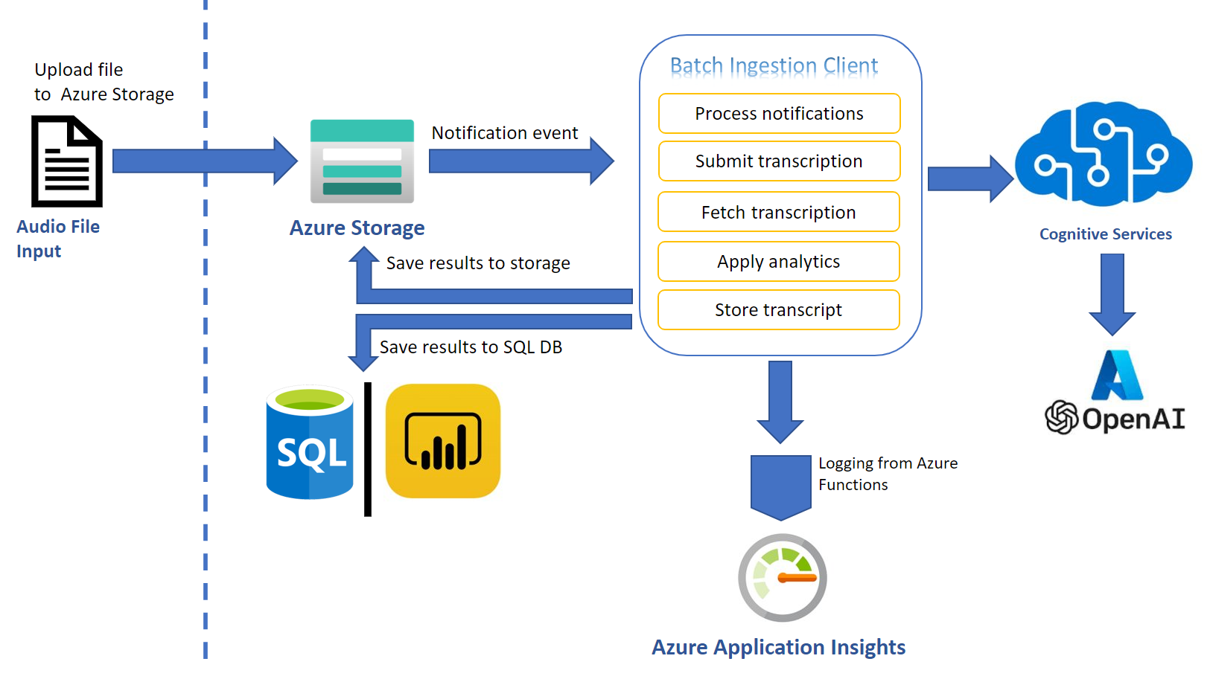
Call Centre Analytics – Information Flow

Slide 22
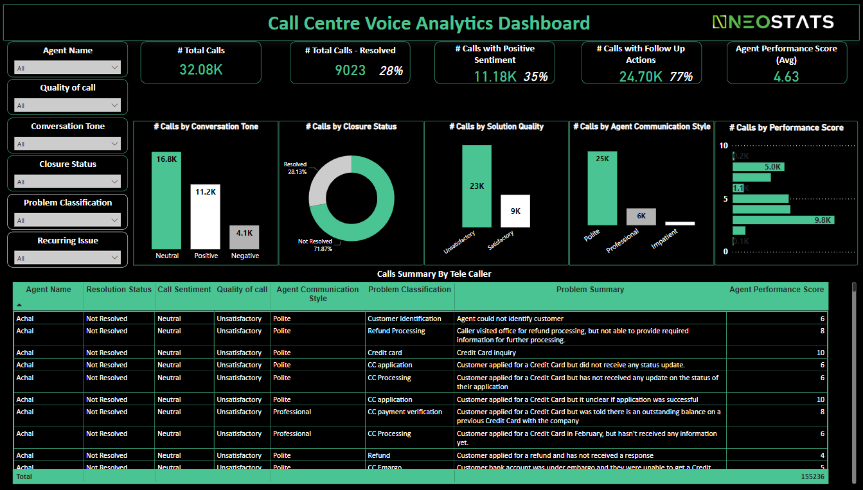
Call Centre Analytics – Data Consumption

Slide 23









Call Centre Analytics – Solution Fitness
Industry Challenges:
Low Visibility
Manual QA
Low Coverage
High Training Cost
Reputational and Compliance Risk
Daily / Realtime Reporting
Auto Call Summary
Auto Call Categorization
Auto QA Score
100% Call Coverage
Multi-lingual Capabilities
Coaching Identification
Agent Dashboard
Recurring Issue Identification

Slide 24

Judge Copilot
Judiciary’s Challenges:
Manual and Laborious Task – Judgements can often run into 100s of pages
Personal Bias – hard to have personal opinion not influence the outcome
Failure to address all Issues - referencing all previous judgements and applicable statutes

Slide 25
Judge Copilot - Features
Draft Judgement
Develop a judgement draft generator that can pull out relevant historical cases for citations.
1) Introduction & Setting
Court
Judge
Date of Judgement
Date of Notice of Appeal
Appellant
Respondent
2) Application for Charge
Accused Details
Charge Details
Summary of Proceedings
Reference to Laws
Precedent Cases
Order
3) Legal Proceedings
Complainant
Accused Person
Proofs of Evidence
Charge with Details
List of witnesses with addresses
Date of application
4) Accused Final Written Address
Introduction
Facts
Issue for determination
Arguments
Reference to Laws
Precedent Cases
Conclusion
5) Prosecution final written address
Details
List of witnesses
List of exhibit
Witness statements
6) Judgment

Slide 26
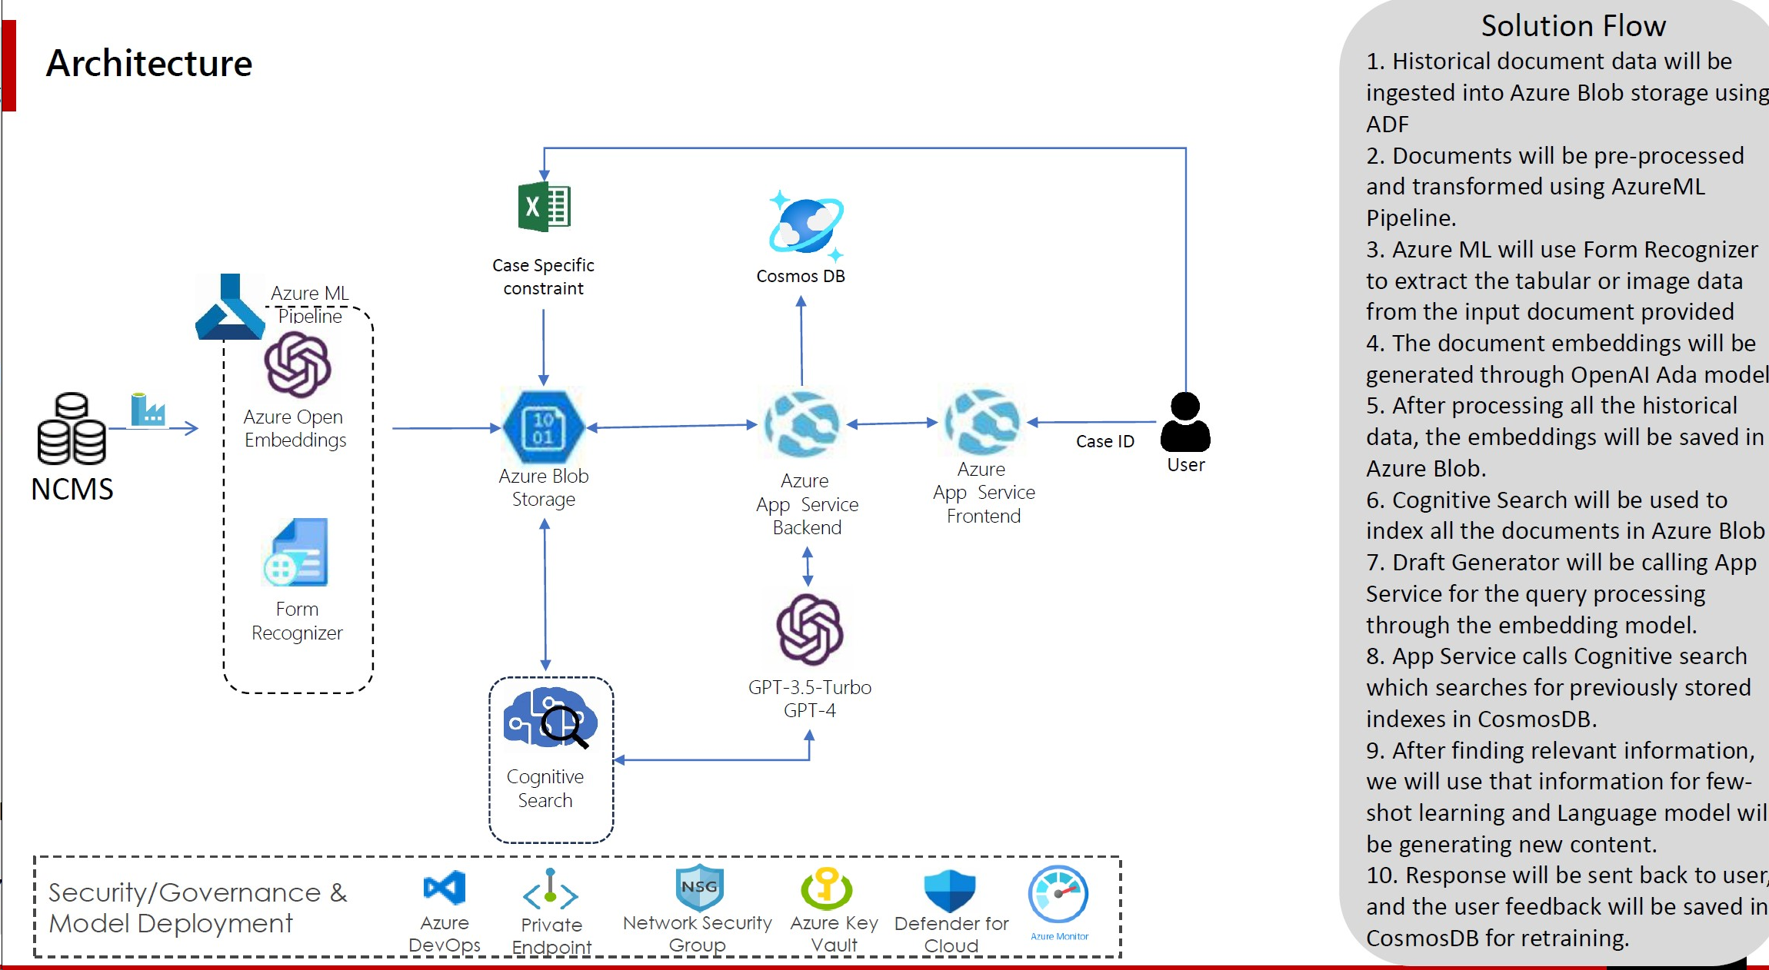
Judge Copilot - Architecture

Slide 27
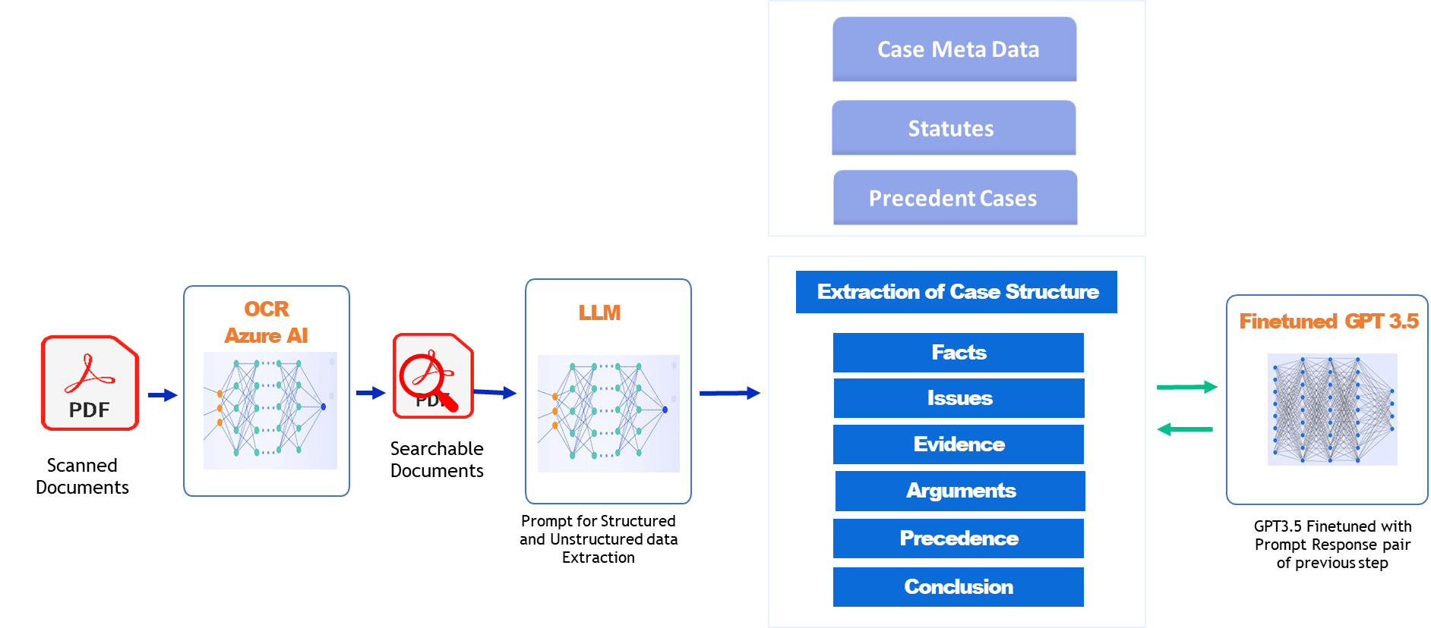
Judge Copilot - Process

Slide 28
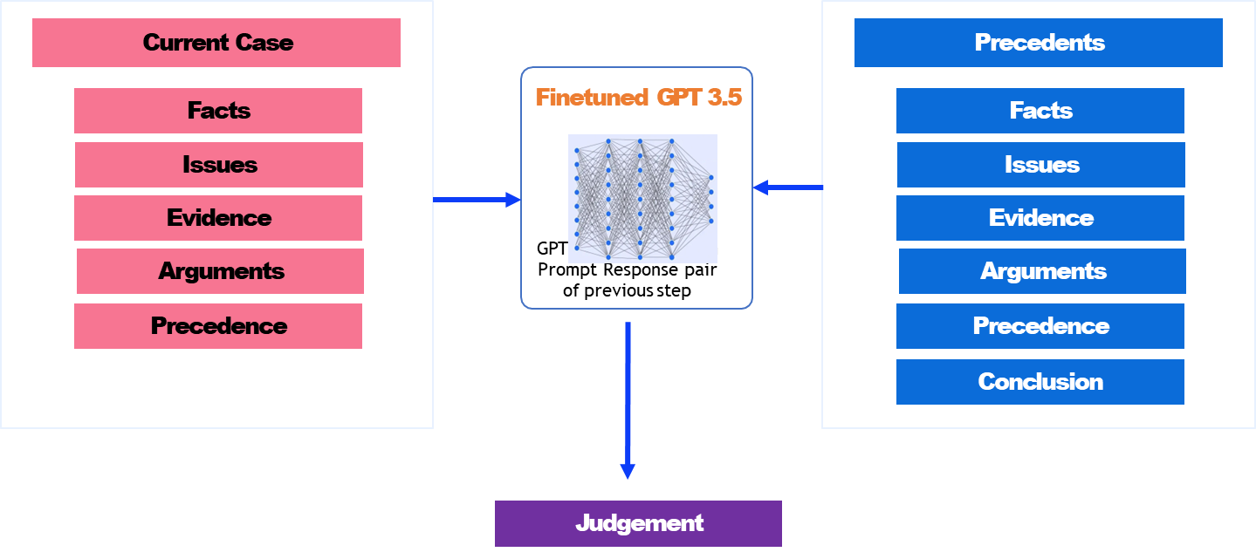
Judge Copilot - Process

Slide 29
Judge CoPilot

Slide 30
Q & A

Slide 31
THANK YOU!
Sachin Kumar Manjhi
NeoStats Analytics
Sachin.Manjhi@theNeoStats.com
Bangalore, India

